Slide 1

Pseudo Live Project
BY GROUP ‘C’

Slide 2
TEAM MEMBERS:
Hilor Ojha - 0142758 (TL)
Mihir Jain - 0142719
Smit Patel - 0142262
Manish K Nagle - 0142707
Lavanya VM - 0142696
Nishitha Thomas - 0142968
Unnatha Nathi - 0142739
Sandhya Nakka - 0142732

Slide 3
What is Page Object Model?
Page Object Model is an Object Repository design pattern in Selenium Web Driver.
POM creates our testing code maintainable and reusable.
Why do we use POM?
A better approach to script maintenance is to create a separate class file which would find web elements, fill them or verify them. This class can be reused in all the scripts using that element.
In future, if there is a change in the web element, we need to make the change in just 1 class file and not 10 different scripts.

Slide 4
Data Driven Framework:
Data Driven automated testing is method in which the test data set is created in the excel sheet, and is then imported into the automation testing tool to feed to the software under test.
In this type of framework the data is not hardcoded with script, but is provided from external source.

Slide 5
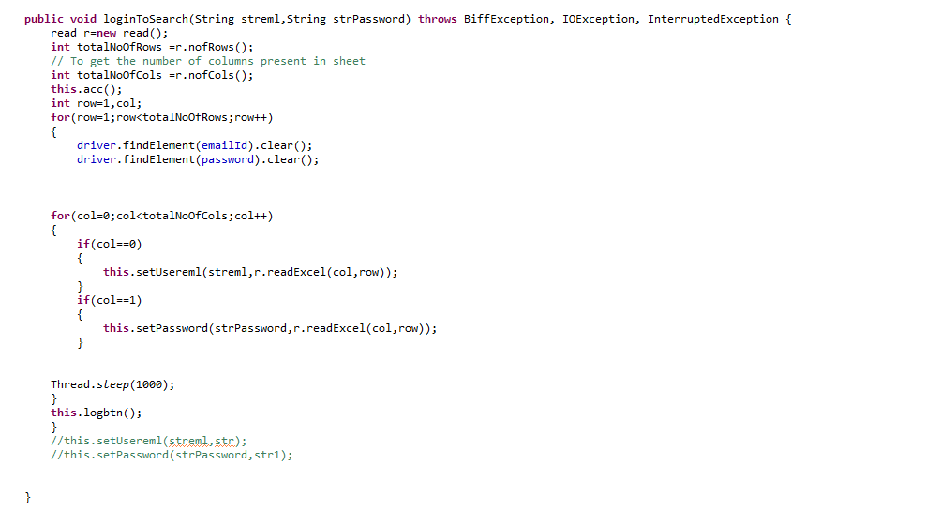

Accessing excel sheet data into the function:

Slide 6
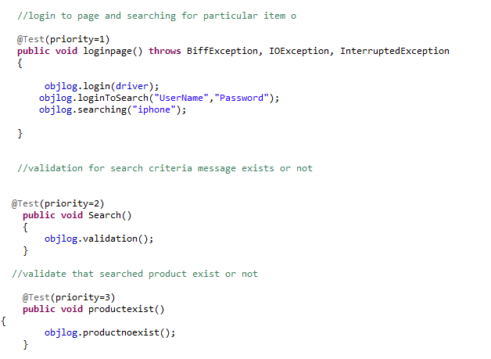
Calling Log in function from the locator file:

Slide 7
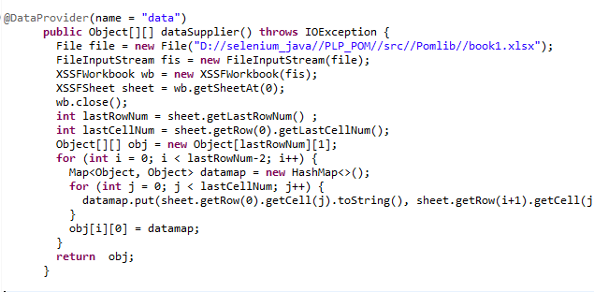
Providing data using HashMap:

Slide 8
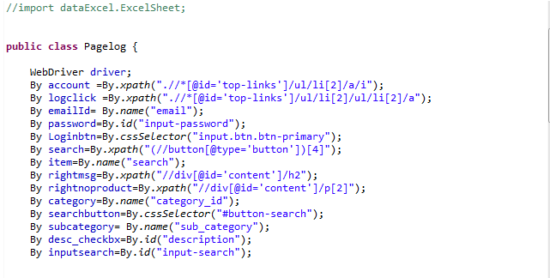
Declaring Locator :

Slide 9
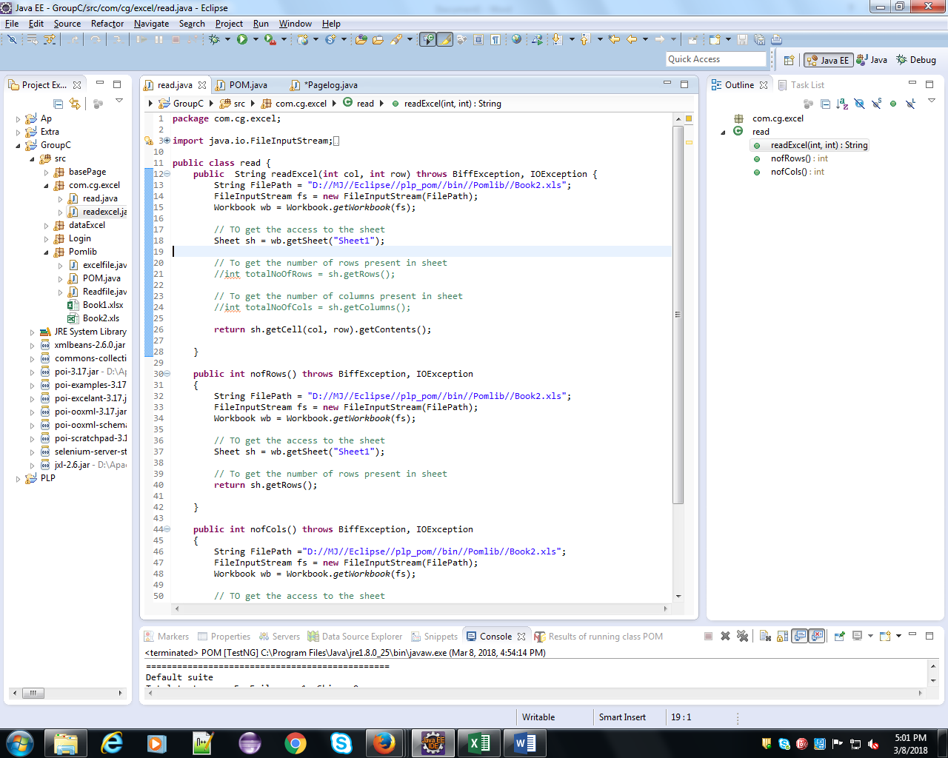
Reading Excel Data:

Slide 10
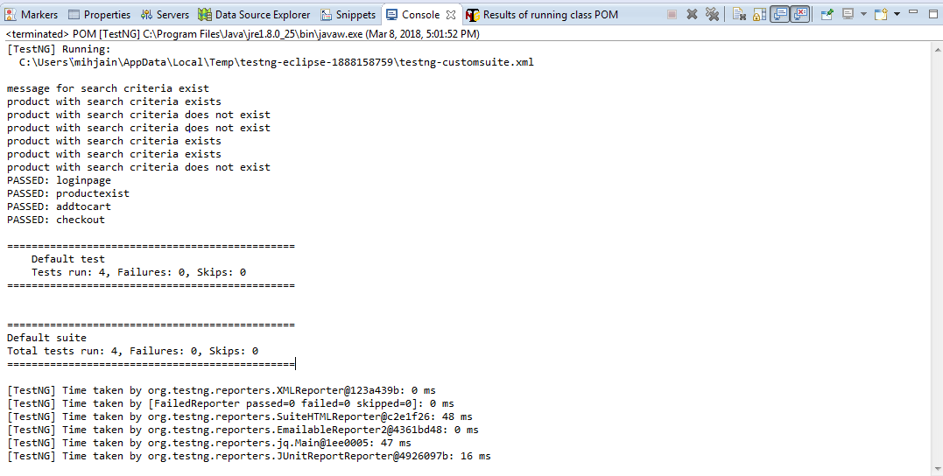
TestNG Output:

Slide 11
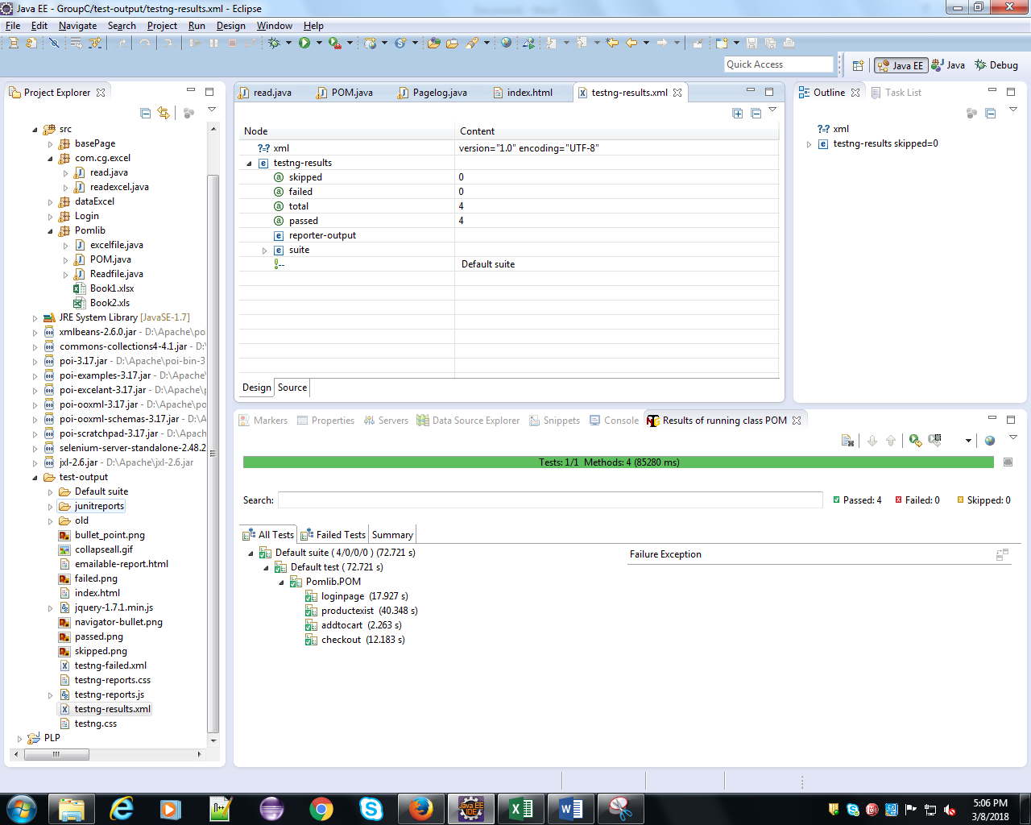
TestNG Report:

Slide 12
Q & A

Slide 13


